Slide 1
Programming c++ final project
Lecturer’s name: en. Muhammad adib bin izzudin
Group members:
Ahmad fahmi bin azlan@ azlan amin (a17dw4144)
Nur Aqilah syahirah binti jayen @ supaat (a17dw2330)

Slide 2
Introduction.
Encryption is the process of transforming information so it is unintelligible to anyone but the intended recipient. Decryption is the process of transforming encrypted information so that it is intelligible again. A cryptographic algorithm, also called a cipher, is a mathematical function used for encryption or decryption. In most cases, two related functions are employed, one for encryption and the other for decryption.

Slide 3
objective.
Provides security for data at all times.
Maintains the integrity of data.
Protects the privacy.
Part of compliance.
Protects data across devices.

Slide 4
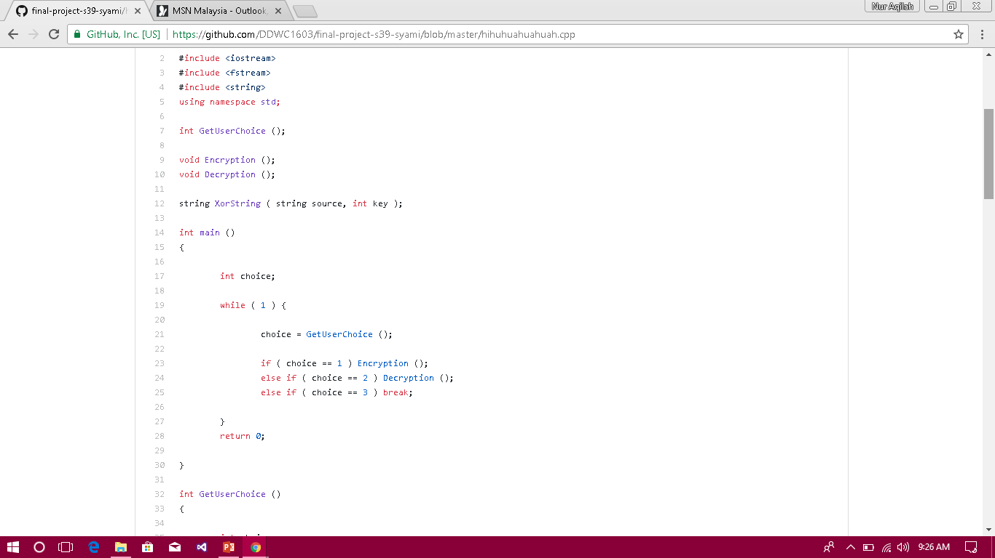

Slide 5
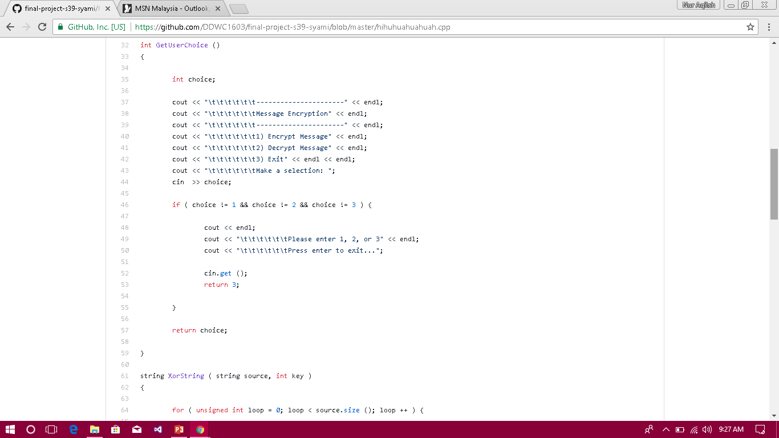

Slide 6
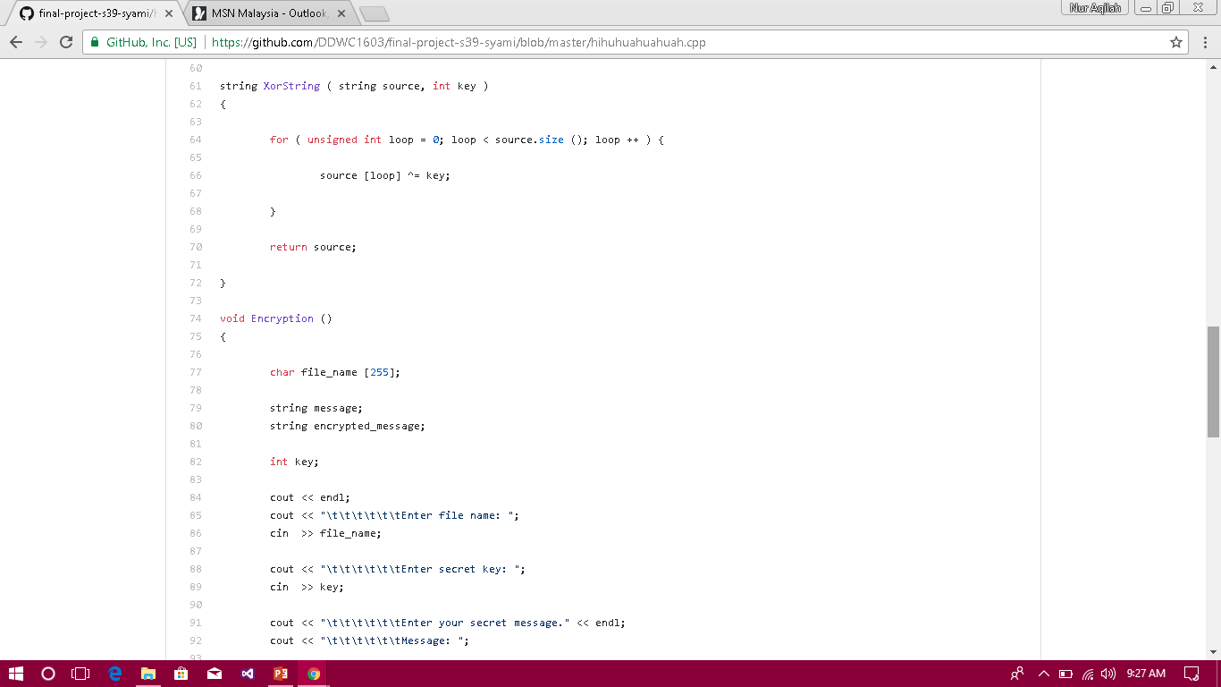

Slide 7
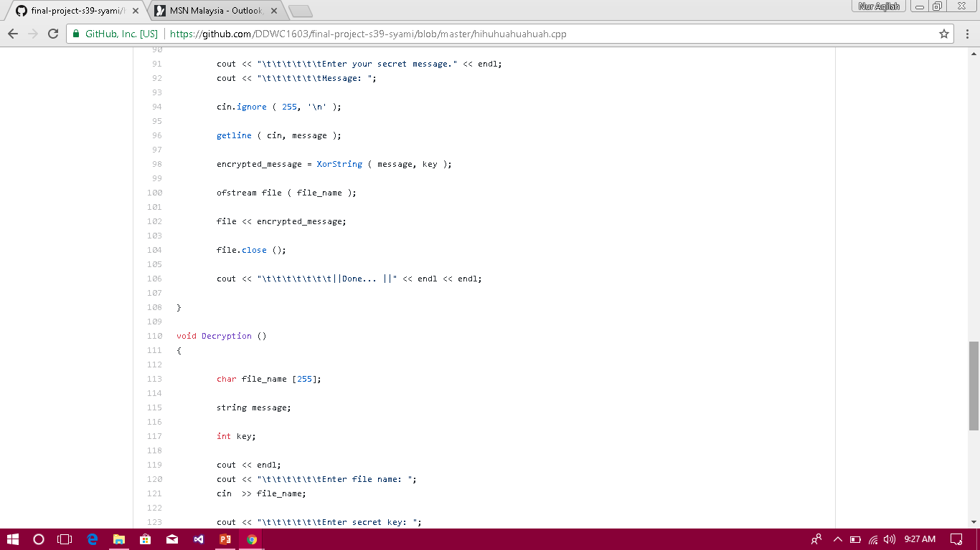

Slide 8
